Slide 1
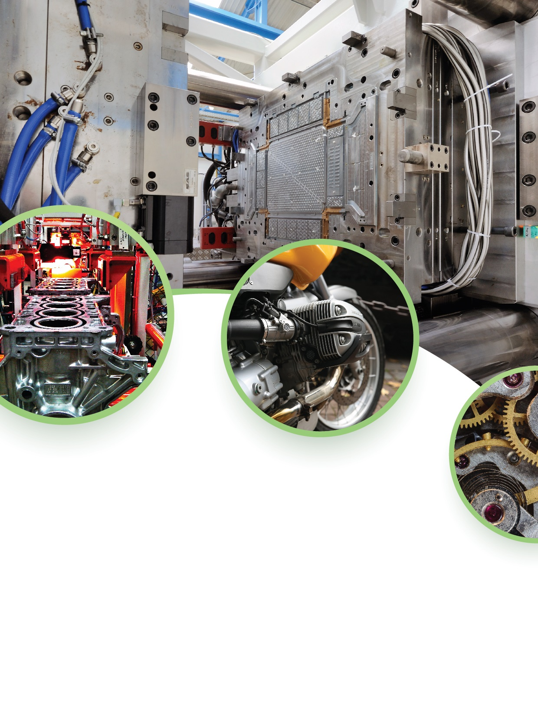
2019 ASEAN Automotive Parts Manufacturing Summit
Lower Emissions, Higher Efficiency
November 5-6, Jakarta, Indonesia,
JS Luwansa Hotel and Convention Center
Organizer
Media
Supports

Slide 2
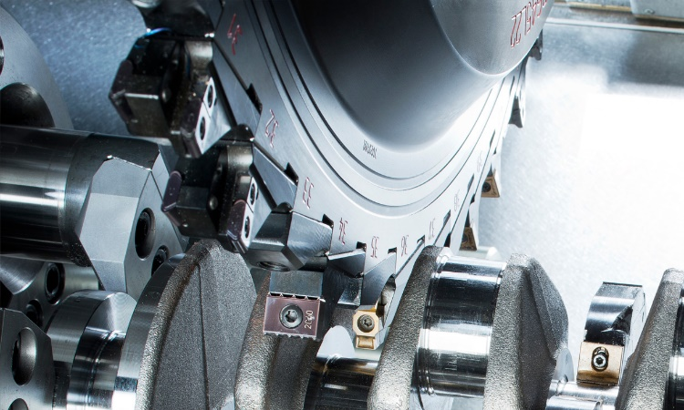
Indonesian automotive manufacturing sector:
The automotive industry of Indonesia has become an important pillar of the country's manufacturing sector. Attracted by low per capita-car ownership, low labor costs and a rapidly expanding middle class, various global car-makers (including Toyota and Nissan) decided to invest heavily to expand production capacity in Indonesia and may make it their future production hub. Others, such as General Motors (GM) have come back to Indonesia.
Moreover, Indonesia experienced a remarkable transition as it evolved from being a merely export oriented car production center (especially for the Southeast Asian region) into a major (domestic) car sales market due to rising per capita GDP. Indonesia accounts for about one-third of total annual car sales in ASEAN, followed by Thailand on second position. Indonesia not only has a large population (264 million inhabitants) but is also characterized by having a rapidly expanding middle class. Together, these two factors create a powerful consumer force.
Government developments plan for automotive industry:
The Indonesian government is eager to turn Indonesia into a global production base for car manufacturing and would like to see all major car producers establishing factories in Indonesia as it aims to overtake Thailand as the largest car production hub in Southeast Asia and the ASEAN region. On the long-term, the government wants to turn Indonesia into an independent car manufacturing country that delivers completely built units (CBU) of which all components are locally-manufactured in Indonesia.
The Indonesian government also has high hopes for the country's car exports (thus generating additional foreign exchange revenues), particularly since the implementation of the ASEAN Economic Community (AEC), which turns the ASEAN region into one single market and production area. The AEC and incoming implementation of Euro4 Emission Standards should unlock more opportunities for exporters as it intensifies regional trade.

Slide 3
Hot Topics
Components manufacturing
Supply solutions
Use of laser binding techniques in achieving high adhesion strength of metal-plastic hybrid materials.
Interactive components for human machine interface (HMI) - how to improve your manufacturing efficiency
Innovative power management solutions for vehicle electrification
Usage of CAE for verifying crashworthiness design issues for lightweight materials.
Hyper-precision molding and contract assembly of safety-critical automotive products, including fuel, brake, steering and transmission components
Selective laser melting as a way to procure a stainless steel with both enhanced strength and ductility.
Plastic:
The use of rigid and elastomeric thermoplastic polyolefins (TPOs) in automotive and ground transportation
Thermal Analysis and Dynamic Mechanical Analysis in Plastics and Rubber
Overmolding as a solution for harsh requirements of automotive fluids sealing
High-Performing Vehicle Thermal Management & Automotive HVAC
Metalworking:
How to avoid defects in hot chamber hpdc
Lube Free Die Casting
Modelling Heat Removal by Die Spray Consortium
Advanced Technologies such as Squeeze Casting & Semi-Solid Casting
Controlled-pressure diffusion bonding
High Integrity High Pressure (HIHP) Casting Innovations
Chemical, Mechanical & Physical Properties of High Vacuum
Materials
OEM’s
Plastic:
Rapid Creation of Tooling with Conformal Cooling.
Lightweight thermoplastics such as PEEK HMF (High Modulus Fiber)
Carbon Fiber-Reinforced Thermoplastic Composites (CFRTP)
Metalworking:
Cavitation Measurement using ABS (Acoustic Bubble Spectometer)
The cycle time reduction benefits of utilizing high conductivity alloys in die components
How to further increase the strength of T6 Heat Treated Low-Iron Alloys
Design/development processes that ensure long-term automotive manufacturability, and value-added solutions for enhanced efficiencies
How 5G Will Influence Autonomous Driving Systems
Achieving Automotive Standards by utilizing proper ERP software systems
Differences between Automated, semi-automated & manual assembly
Transforming data into competitive advantage.

Slide 4
Industry Chain - Participants Products
The focus of “ASEAN Automotive Parts Manufacturing Summit” in Jakarta, Indonesia; is the functional and structural elements of internal automotive construction. This is event is dedicated to components and systems manufacturers that provides biggest added value to the performance of various elements in the car environment system – from safety, through information to comfort of using.
Metalworking
Delegates
Speakers
Tier 3 – 20%
Tier 2 – 60%
Tier 1 – 10%
OEM – 10%
Cars
2-wheelers
3-wheelers
Advanced high Strength steel
Ultra High strength steel
Aluminium alloys
Magnesium alloys
Manganese alloys
Powertrains
suspension systems
Diesel systems
Steering systems
Brake systems
Gearboxes
Chassis
Ignition coils
Engine application Components
Various bearing types, clutch discs, pressure plates, transmission, gearbox
Engine parts: valves, primary and auxiliary drives, camshafts, pistons
Steering and Suspension components
Brake System parts
Plastic
Tier 3
Tier 2
Tier 1
OEM
Paint and coatings
Carbon fibre reinforced plastics (CFRP)
Polypropylene (PP)
Polyurethane (PUR)
Poly-vinyl-chloride (PVC)
Acrylonitrile butadiene Styrene (ABS)
Cars
2-wheelers
3-wheelers
Interior: fans, intake manifolds, air ducts, storage compartments, air channels, nozzles, A/C components
Engine parts casings
Connectors
Brackets
Gas caps
Pedal pads
Gas tank rollovers
Bumpers
Sensors
Control units or engines, wiring
Fuel systems
Battery systems
A/C system
Filter systems
Telematics

Slide 5
Industry Chain - Participants Equipments Needs = Sponsor Type
Metalworking
Tier 3
Tier 2
Tier 1
OEM
Die casting machines
High-performance CNC for metal cutting
Machine Control Motion Control
3D printing machines
Various laser systems
Quality control
Roll forming
Drawing
Bending
Cold stamping
Laser welding
Induction welding
Tube forming
Hot stamping
Tensile testing machinery
Hand tools
Automatic conveyors
Spot welding robots
Assembly robots
Material handling machines
Steel stamping
Die-casting & Chilled iron castings
Roll forging
CNC turning centres – lathe, milling, grinding, drilling
Broaching machines
Shearing machines
Plastic
Tier 3
Tier 2
Tier 1
OEM
Hand tools
Automatic conveyors
Spot welding robots
Assembly robots
Material handling machines
Injection molding
(1K, 2K, IMC)
Compression molding technology
Extrusion blow molding
Hand tools
Automatic conveyors
Spot welding robots
Assembly robots
Material handling machines
Machine Control
Motion Control
3D printing machines
Various laser systems
Quality control inspection systems
Thermoplastic/LSR injection molding
Extrusion molding

Slide 6
Reasons Why You Should Attend
Face-To-Face Communication With Your Peers:
Meet industry experts, fellow manufacturers, suppliers, regulators, distributors, academe as well as R&D researchers from automotive, motorcycle and supporting industries like machining, metrology, cutting tools, plastics, automation, mold and die etc. Learn about regional needs and future manufacturing trends.
Be Updated About The Latest Market Trends And Prospects:
Get ideas, gain insights and learn best practices in processing and design in the metalworking and plastics industries.
Learn From The Industry Experts:
Discover new products, services and solutions for your business to generate higher profitability.
Visit Exhibitors' Booths:
Attend one-to-one meetings with potential partners not only from Vietnam but across the region.
Meet New Suppliers and Agents:
Build your business network at a relaxing and friendly atmosphere.
Build Your Business Network:
With focus in Auto and Motorcycle Parts Manufacturing, Precision Machining, Lightweighting,
Intelligent Automation, Testing & Measuring Equipment ROI and training.
Venue Hotel - Your Business & Leisure Experience
A luxurious business hotel in Jakarta, Indonesia!
JS Luwansa Hotel and Convention Center
JS Luwansa Hotel and Convention Center, Jakarta's first class international upscale hotel, located in the city center in Jakarta. Strategically located near all major commercial, diplomatic and government offices, the hotel is located in the main road of Jl. HR Rasuna Said, which gives you swift access to all major offices building.
Address:Jl. HR Rasuna Said Kav C-22, Jakarta 12940, Indonesia
Tel: (62) (21) 2954 3030
Website: www.jsluwansa.com/default-en

Slide 7
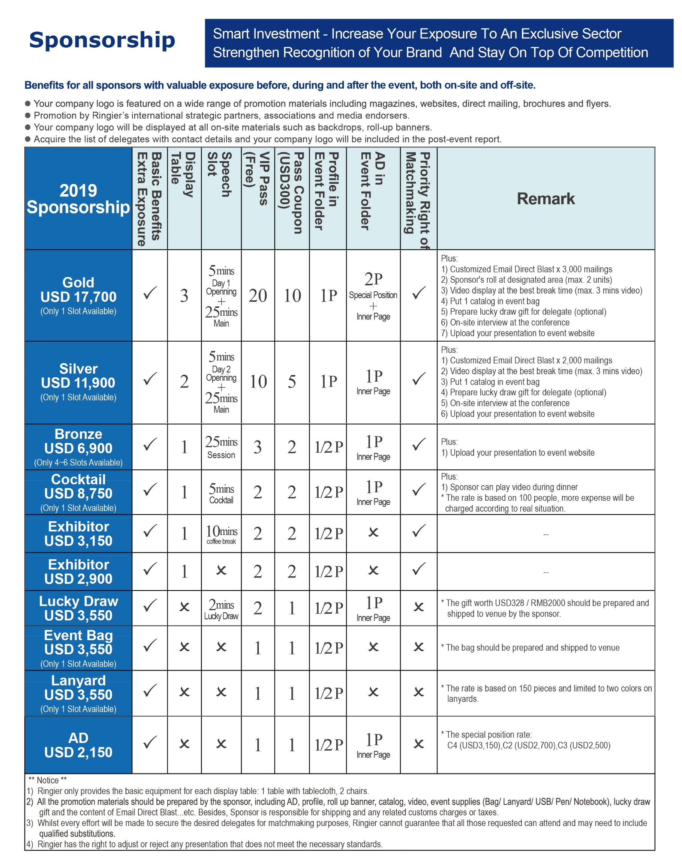

Slide 8
ABOUT RINGIER
Taking advantage of powerful media resources, Ringier Conference covers the industries of plastics, food, personal care, medicine & health care, nonwovens, coatings & ink, automobile, metal, mold & die, package, composite material, and the latest technologies. Since 2003, we organize over 20 high level conferences bringing industry leaders together for information exchange and networking opportunities in China and successfully extend into S.E. Asia from 2014.
A series of conferences in S.E. Asia that cater specifically to industry verticals like metalworking technology, plastics processing, automotive, food beverage processing & packaging representing growth sectors in many S.E. Asia countries. These sectors require high levels of technology and upgrading to meet the growing needs of sophisticated consumers both domestically and for export markets.
Conferences organized by Ringier not only provide industry leaders with the latest technologies, but also help Greater China enterprises innovatively explore new markets. For more information, please visit www.ringierevents.com
CONTACT US
Mr. Tymoteusz
T. +886-4-23297318
E. timothy@ringier.com.hk

